Slide 1
Deep Learning in Image Processing
Topics:
CNNs 101
Image Processing Pipelines
Frank Dellaert
CS 4476 Computer Vision
Many slides from Stanford’s CS231N by Fei-Fei Li, Justin Johnson, Serena Yeung, as well as some slides on filtering from Devi Parikh and Kristen Grauman, who may in turn have borrowed some from others

Slide 2
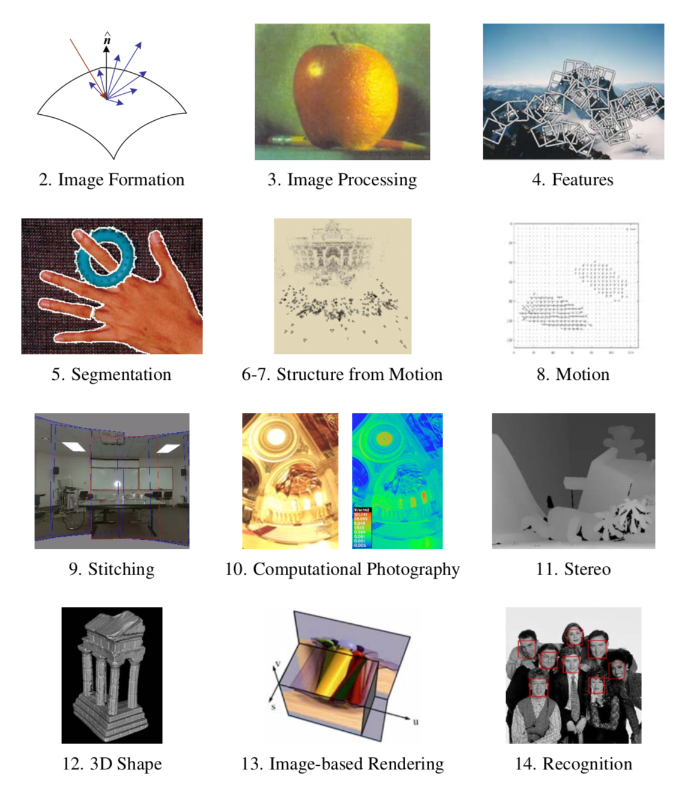

Slide 3
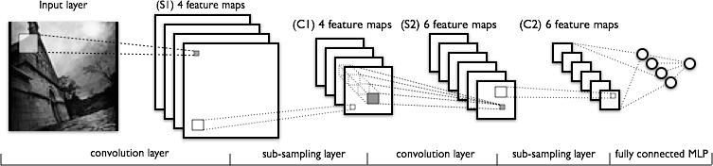
Convolutional Neural Networks
a
Image Credit: Yann LeCun, Kevin Murphy

Slide 4

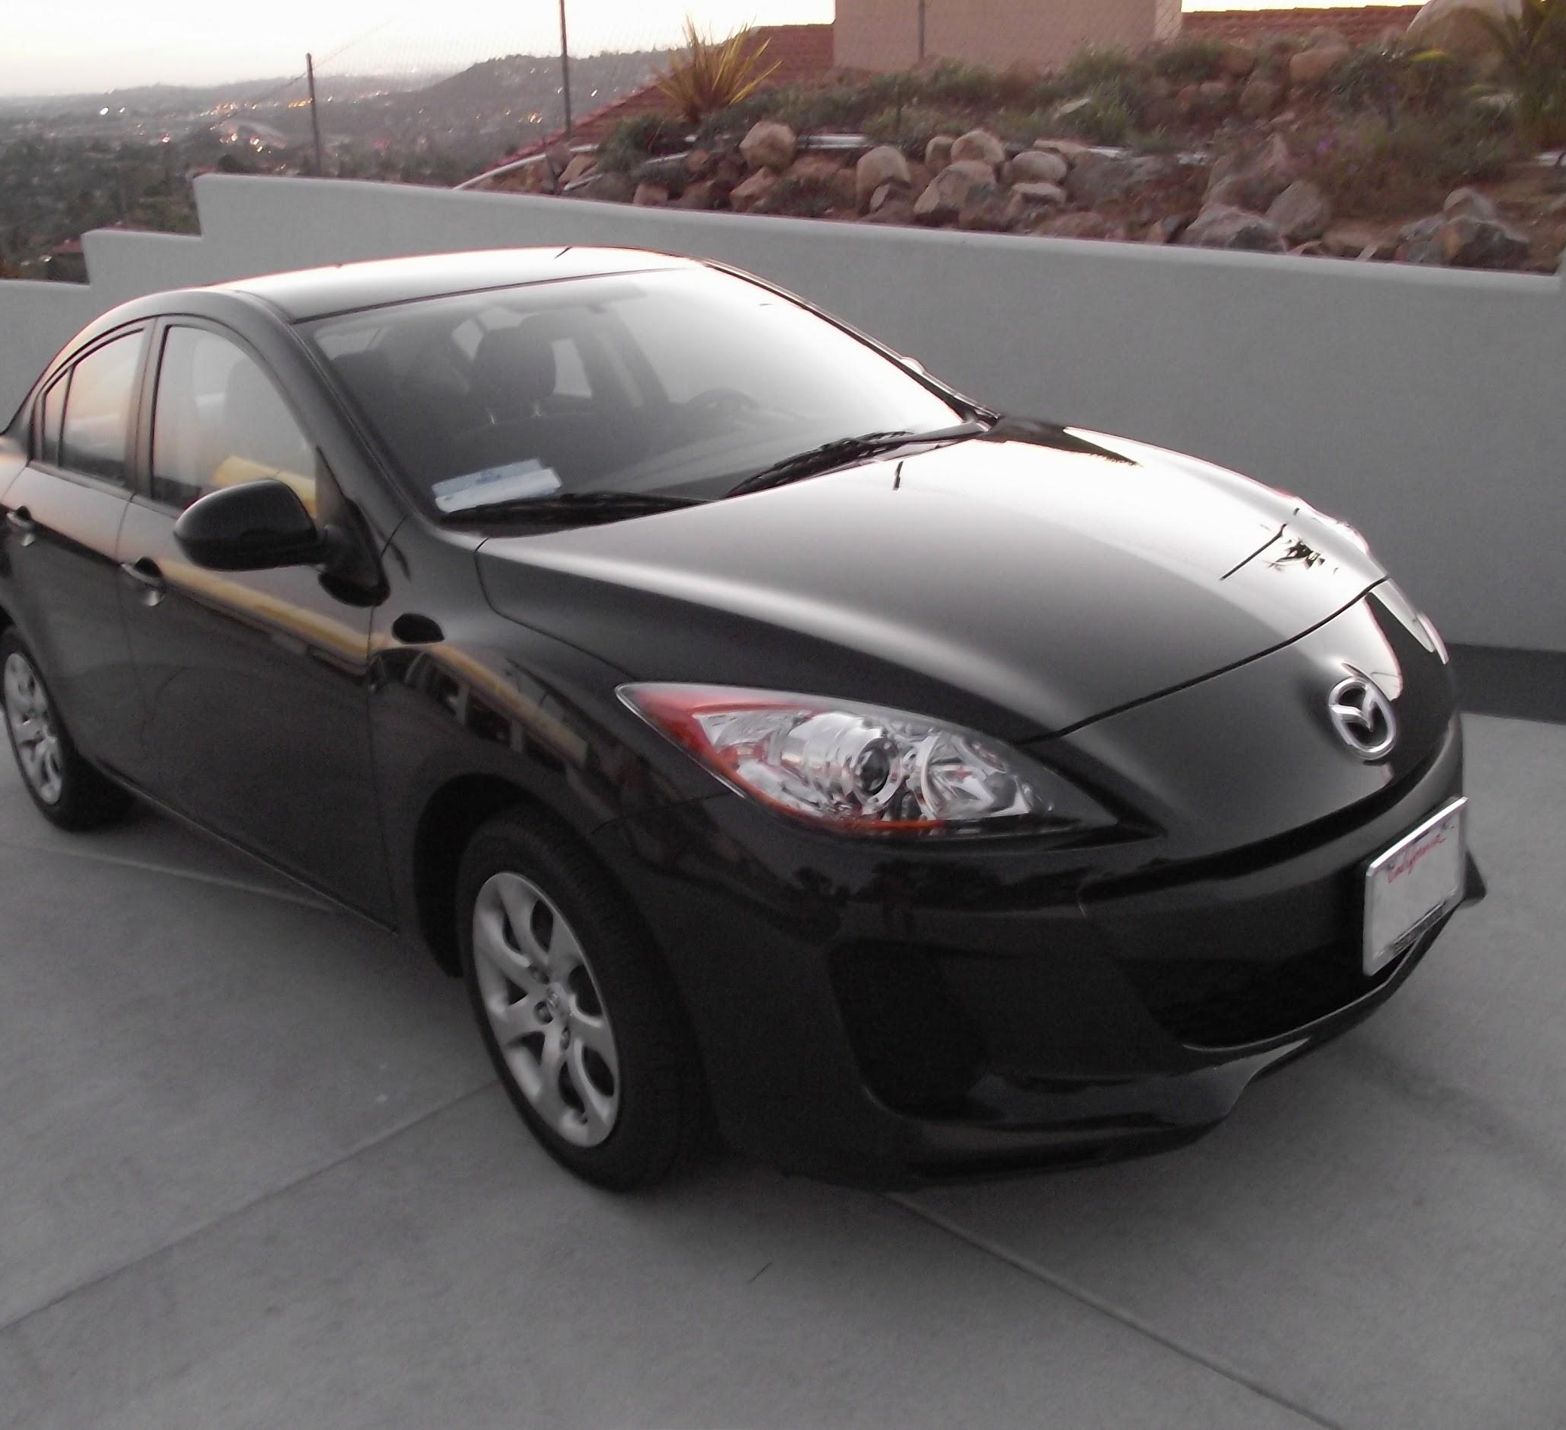
preview:
Slide Credit: Fei-Fei Li, Justin Johnson, Serena Yeung, CS 231n
Notes:
Convnet is stack of layers
Look at how an image progresses through the network, and sizes of output after each layer
Car image is photo taken by Lane McIntosh, permission to use.

Slide 5
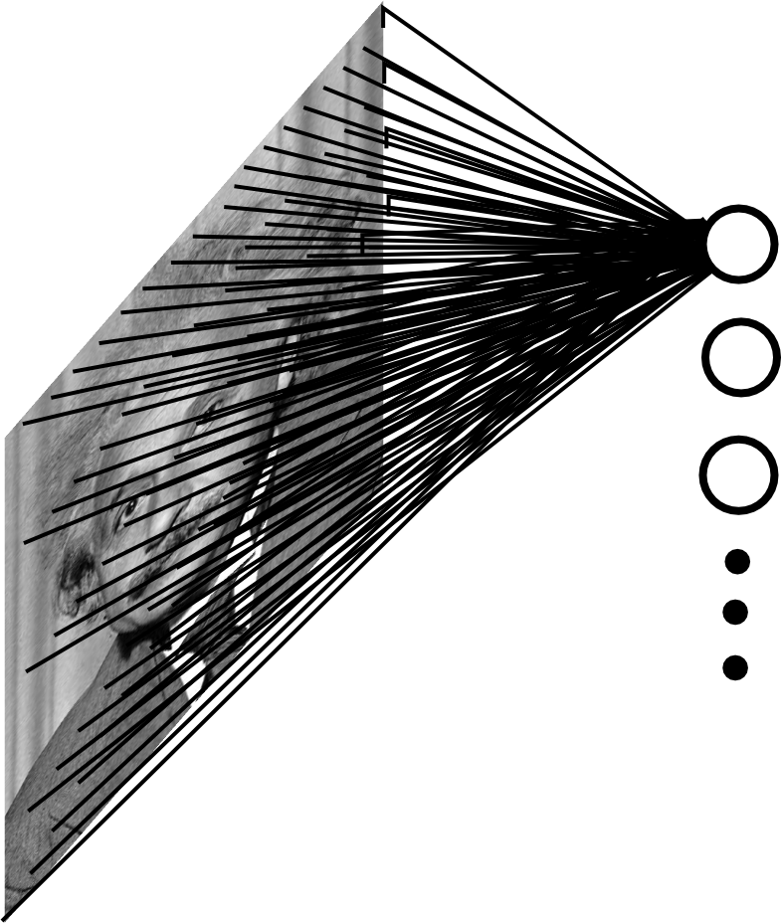
Fully Connected Layer
Example: 200x200 image
40K hidden units
~2B parameters!!!
- Spatial correlation is local
- Waste of resources + we have not enough training samples anyway..
Slide Credit: Marc'Aurelio Ranzato

Slide 6
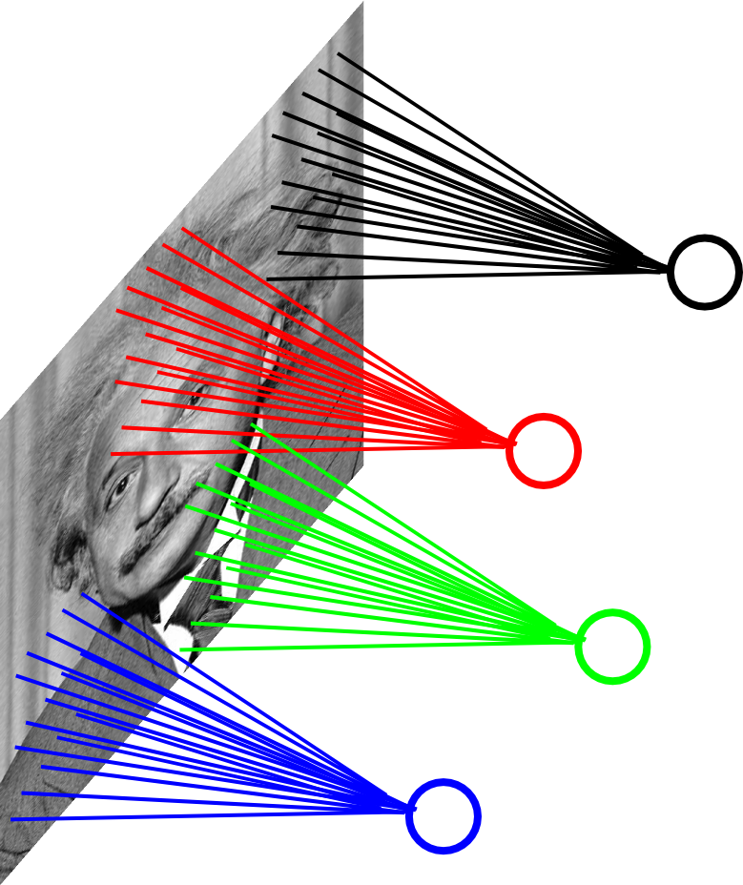
Locally Connected Layer
Example: 200x200 image
40K hidden units
Filter size: 10x10
4M parameters
Note: This parameterization is good when input image is registered (e.g., face recognition).
Slide Credit: Marc'Aurelio Ranzato

Slide 7
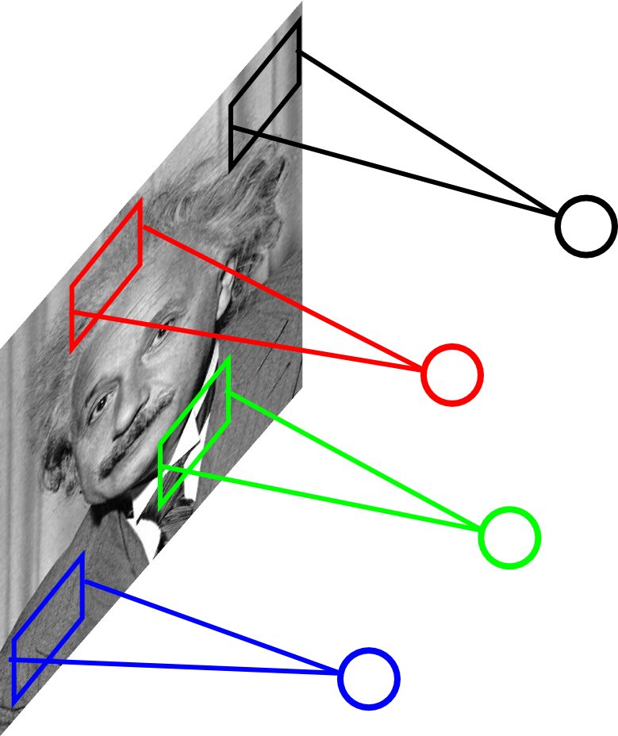
Locally Connected Layer
STATIONARITY? Statistics is similar at different locations
Slide Credit: Marc'Aurelio Ranzato

Slide 8
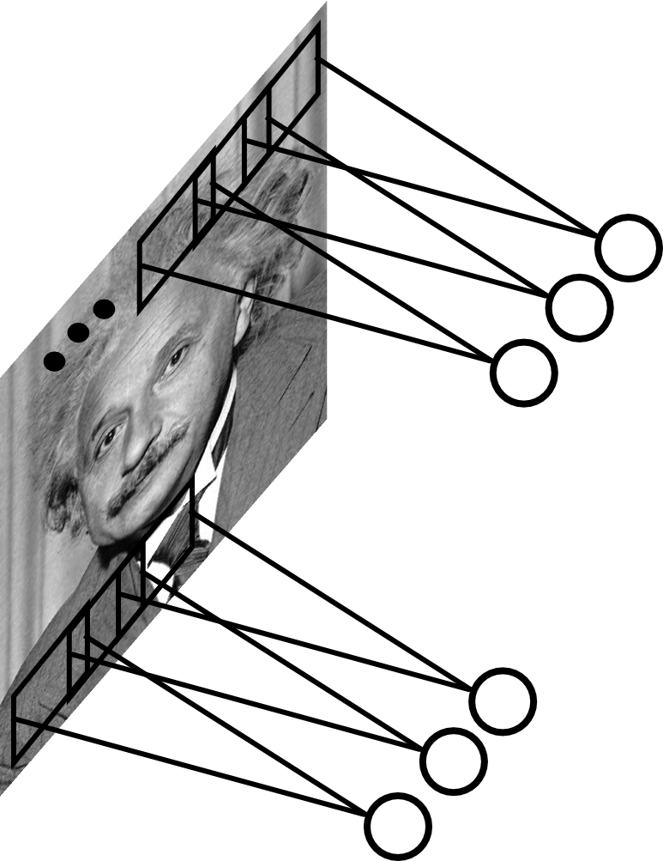
Convolutional Layer
Share the same parameters across different locations (assuming input is stationary):
Convolutions with learned kernels
Slide Credit: Marc'Aurelio Ranzato

Slide 9
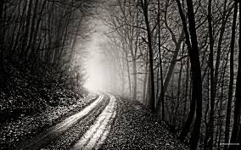
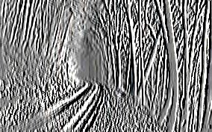
Convolutional Layer
-1 0 1
-1 0 1
-1 0 1
=
*
Slide Credit: Marc'Aurelio Ranzato

Slide 10
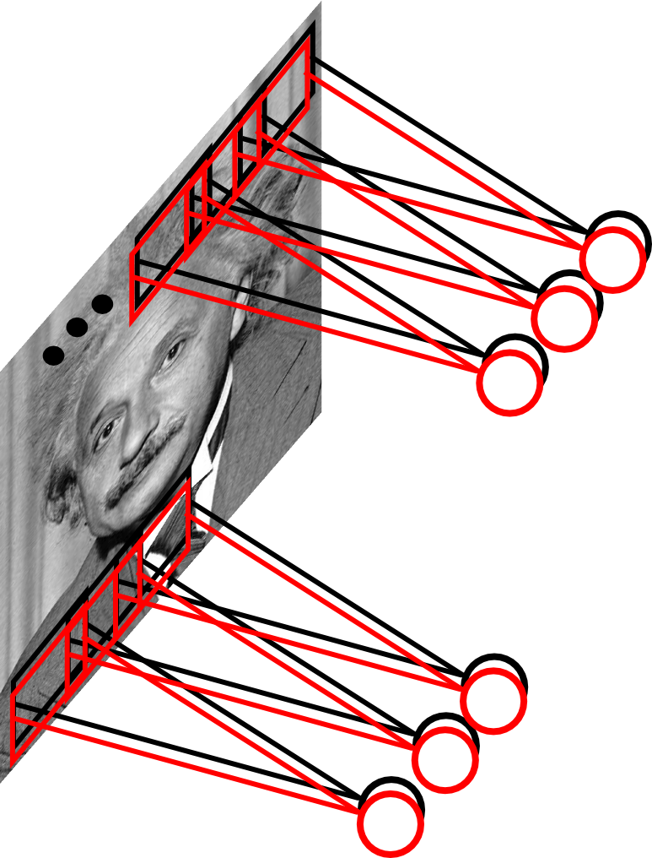
Convolutional Layer
Learn multiple filters.
E.g.: 200x200 image
100 Filters
Filter size: 10x10
10K parameters
Slide Credit: Marc'Aurelio Ranzato

Slide 11


Slide 12
Convolution Layer
32x32x3 image -> preserve spatial structure
32
height
32
width
3
depth
Slide Credit: Fei-Fei Li, Justin Johnson, Serena Yeung, CS 231n
Notes:
Preserve spatial structure of input

Slide 13
Convolution Layer
activation map
32x32x3 image
5x5x3 filter
32
28
convolve (slide) over all spatial locations
32
28
3
1
Slide Credit: Fei-Fei Li, Justin Johnson, Serena Yeung, CS 231n

Slide 14
Multiple filters: if we have 6 5x5 filters, we’ll get 6 separate activation maps:
activation maps
32
28
Convolution Layer
32
28
3
6
We stack these up to get a “new image” of size 28x28x6!
Slide Credit: Fei-Fei Li, Justin Johnson, Serena Yeung, CS 231n

Slide 15
Preview: ConvNet is a sequence of Convolution Layers, interspersed with activation functions
32
28
CONV,
ReLU
e.g. 6 5x5x3 filters
32
28
3
6
Slide Credit: Fei-Fei Li, Justin Johnson, Serena Yeung, CS 231n

Slide 16
Preview: ConvNet is a sequence of Convolutional Layers, interspersed with activation functions
32
28
24
….
CONV,
ReLU
e.g. 6 5x5x3 filters
CONV,
ReLU
e.g. 10 5x5x6 filters
CONV,
ReLU
32
28
24
3
6
10
Slide Credit: Fei-Fei Li, Justin Johnson, Serena Yeung, CS 231n

Slide 17
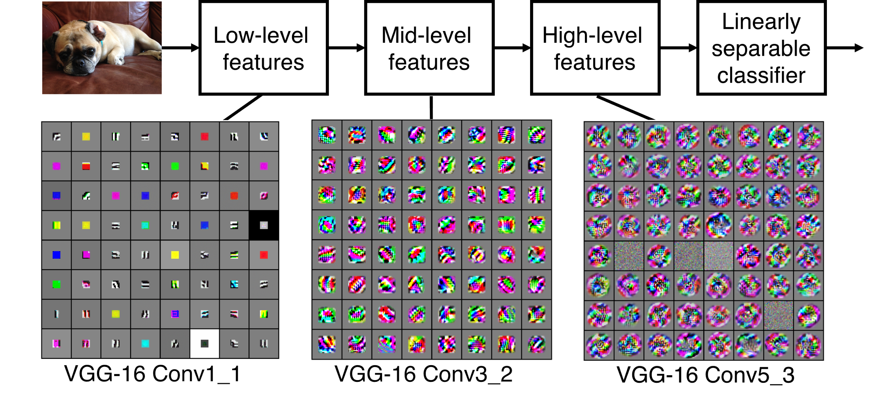
Preview
[Zeiler and Fergus 2013]
Visualization of VGG-16 by Lane McIntosh. VGG-16 architecture from [Simonyan and Zisserman 2014].
Slide Credit: Fei-Fei Li, Justin Johnson, Serena Yeung, CS 231n
Notes:
Each layer has many filters each producing an activation map
what ends up learning is hierarchy of filters, talk more in depth later
In this visualization [Lane] maximized the activity of a central cluster of units from the same filter type in various VGG-16 layers by taking image gradients. So not exactly what Zeiler and Fergus did, but somewhat similar.

Slide 18
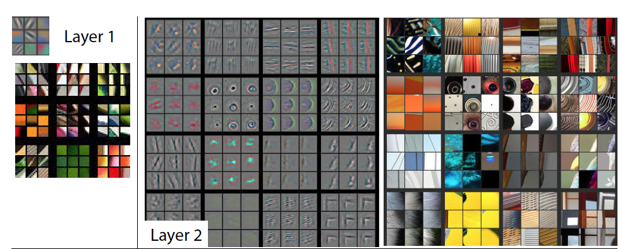
Visualizing Filters
Figure Credit: [Zeiler & Fergus ECCV14]

Slide 19
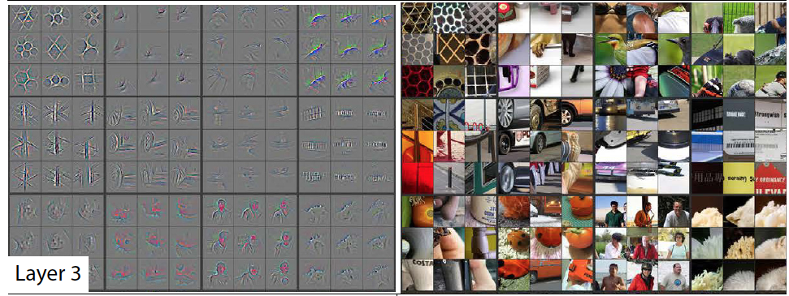
Visualizing Filters
Figure Credit: [Zeiler & Fergus ECCV14]

Slide 20
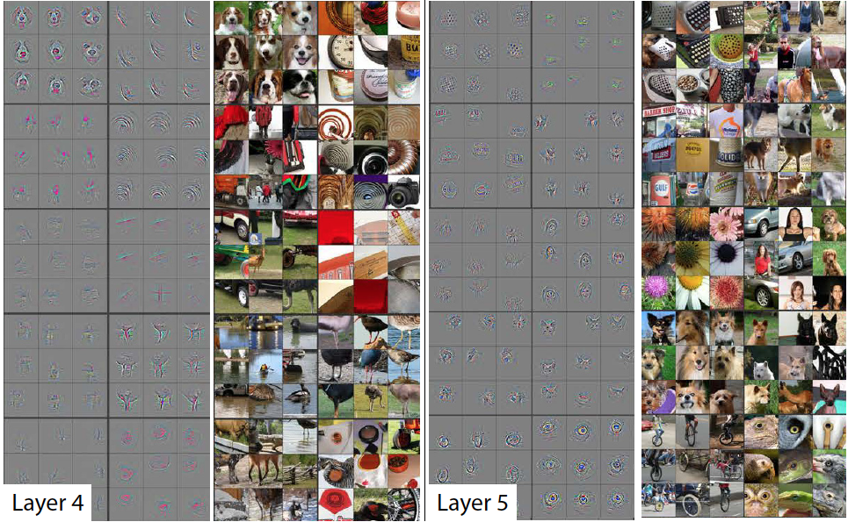
Visualizing Filters
Figure Credit: [Zeiler & Fergus ECCV14]

Slide 21
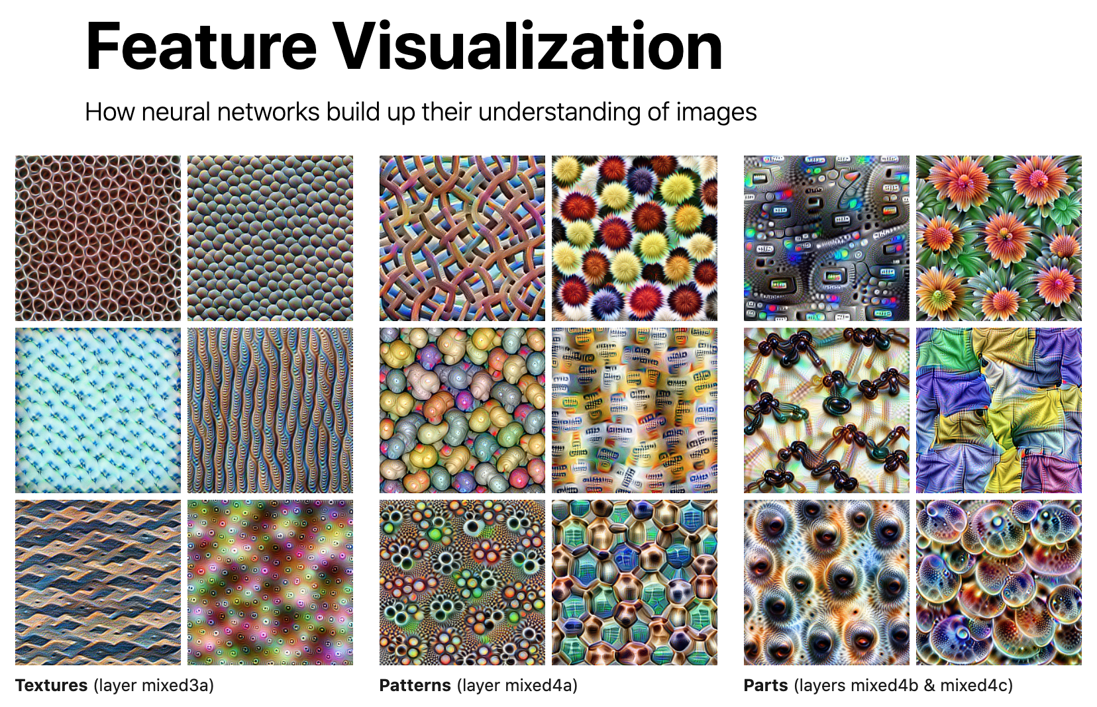
Distill Interactive Visualization

Slide 22
two more layers to go: POOL/FC
Slide Credit: Fei-Fei Li, Justin Johnson, Serena Yeung, CS 231n
Notes:
Car image is photo taken by Lane McIntosh, permission to use.

Slide 23
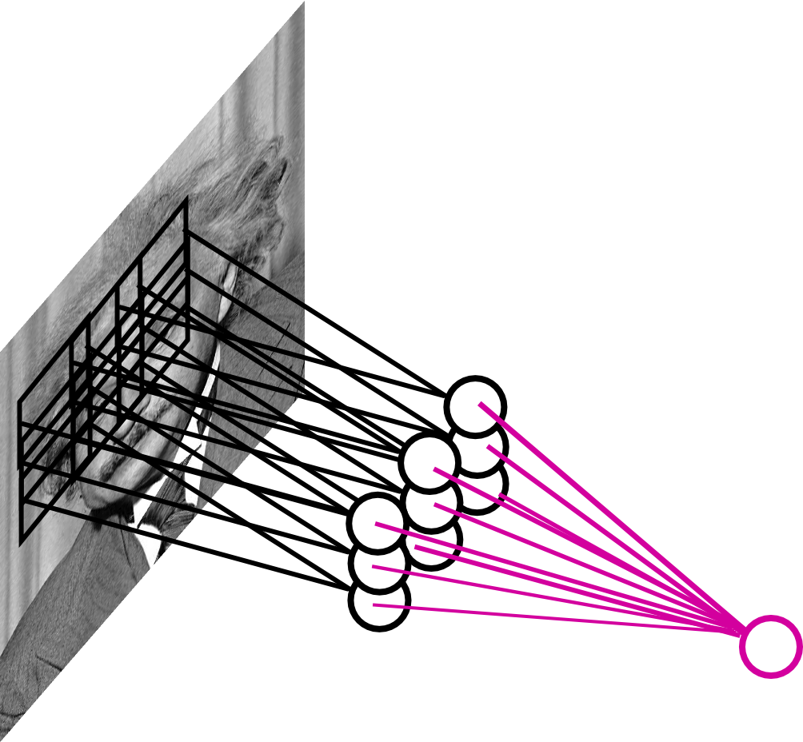
Pooling Layer
By “pooling” (e.g., taking max) filter
responses at different locations we gain robustness to the exact spatial location of features.
Slide Credit: Marc'Aurelio Ranzato

Slide 24
MAX POOLING
Single depth slice
1 | 1 | 2 | 4
5 | 6 | 7 | 8
3 | 2 | 1 | 0
1 | 2 | 3 | 4
dim 1
max pool with 2x2 filters and stride 2
6 | 8
3 | 4
dim 2
Slide Credit: Fei-Fei Li, Justin Johnson, Serena Yeung, CS 231n

Slide 25
Fully Connected Layer (FC layer)
Contains neurons that connect to the entire input volume, as in ordinary Neural Networks
Slide Credit: Fei-Fei Li, Justin Johnson, Serena Yeung, CS 231n
Notes:
Car image is photo taken by Lane McIntosh, permission to use.

Slide 26
Fully Connected Layer
Example: 200x200 image
40K hidden units
~2B parameters!!!
- Spatial correlation is local
- Waste of resources + we have not enough training samples anyway..
Slide Credit: Marc'Aurelio Ranzato

Slide 27
Fully Connected Layer
Each neuron looks at the full input volume
32x32x3 image -> stretch to 3072 x 1
input
activation
1
1
3072
10 x 3072
weights
10
1 number:
the result of taking a dot product between a row of W and the input (a 3072-dimensional dot product)
Slide Credit: Fei-Fei Li, Justin Johnson, Serena Yeung, CS 231n
Notes:
Preserve spatial structure of input

Slide 28
CNNs for Image Processing

Slide 29
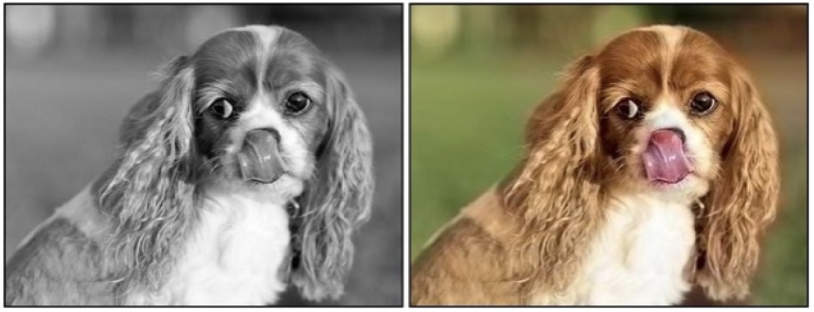
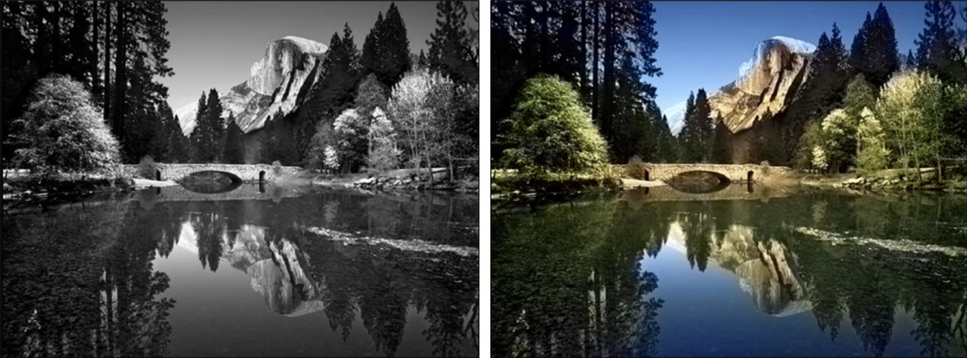
Colorization
Given a grayscale image, colorize the image realistically
Zhang et al. pose colorization as classification task and use class-rebalancing to improve results
Demonstrate higher rates of fooling humans using “colorization Turing test”
Colorful Image Colorization. Richard Zhang, Phillip Isola, Alexei A. Efros. ECCV 2016.

Slide 30
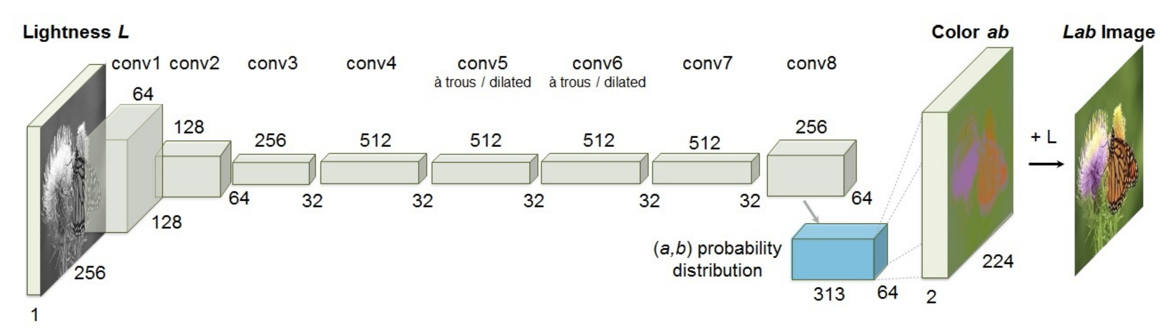
Colorization
Training data: decompose any RGB image into L*a*b color space
L: grayscale input (lightness channel)
ab: color channels
Train CNN with one million color images and a new objective function to incorporate more diverse colors. Many possible correct colorizations!
Colorful Image Colorization. Richard Zhang, Phillip Isola, Alexei A. Efros. ECCV 2016.

Slide 31
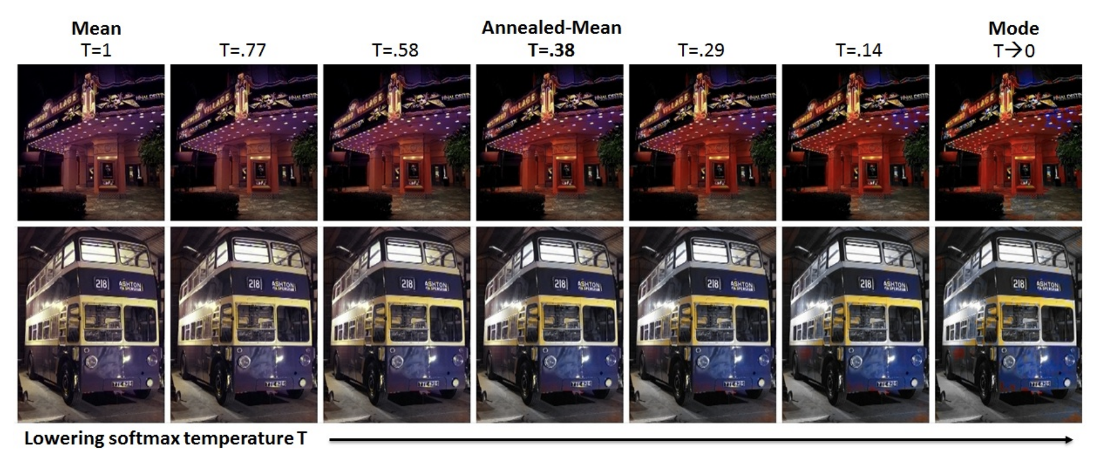
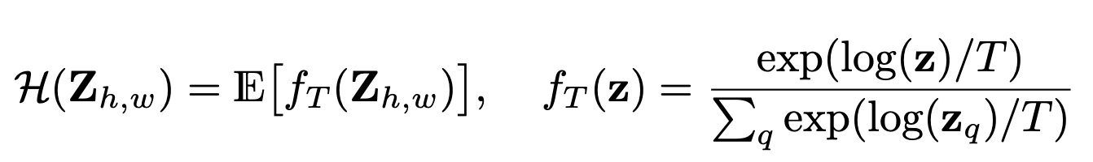
How to convert the inferred distribution to an image?
313-way classification over discretized ab color bins
Network will output a distribution z over colors at each pixel. Need to convert to a single pixel value
Mode: vibrant but sometimes spatially inconsistent (e.g., the red splotches on the bus)
Mean: produces spatially consistent but desaturated results, exhibiting an unnatural sepia tone

Slide 32
DeOldify
https://github.com/jantic/DeOldify

Slide 33
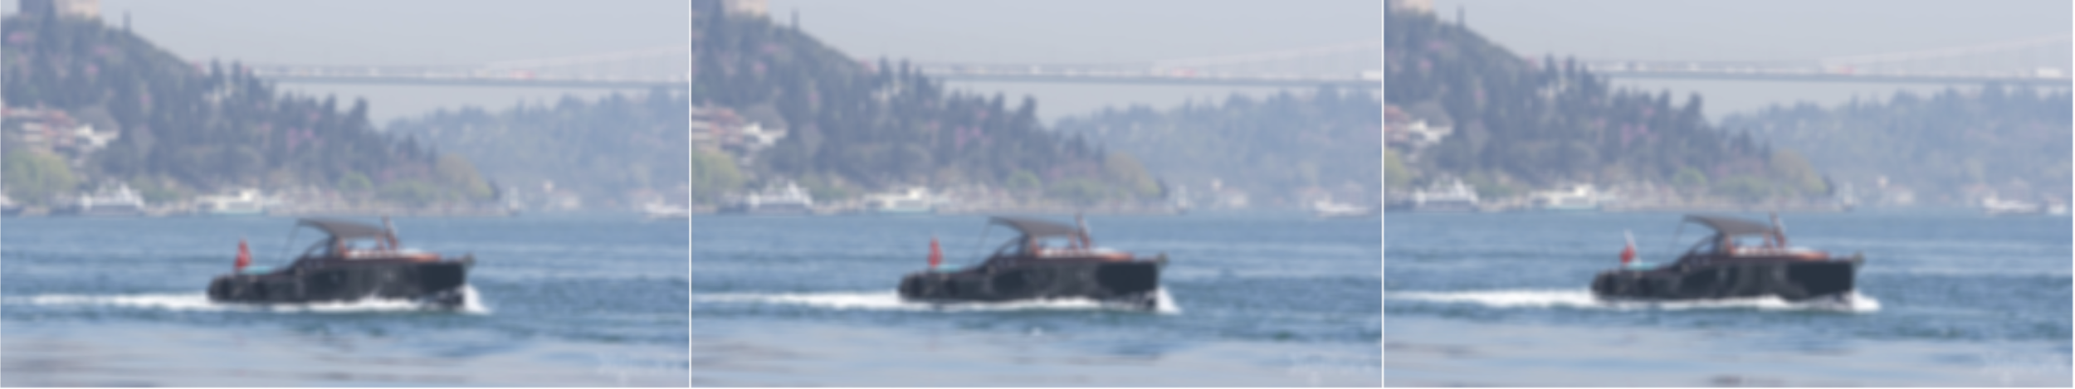
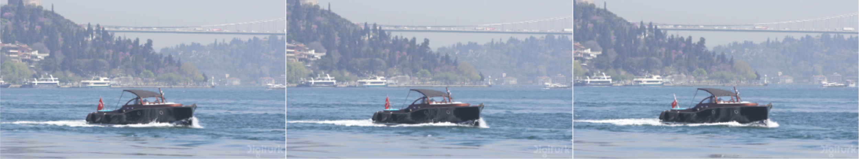
Super-Resolution
Low resolution
High resolution

Slide 34
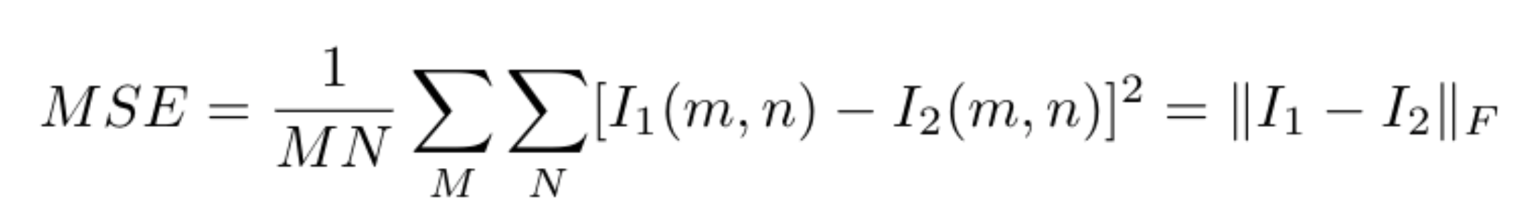
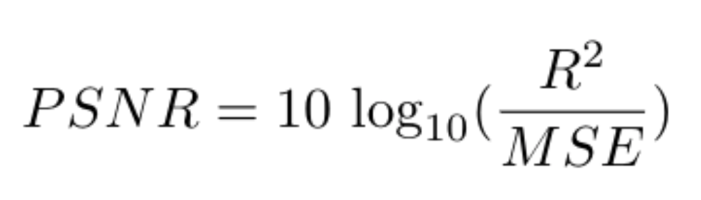
Super-Resolution as a task
Quality-degrading factors / sources of noise:
Camera shake, shadows, motion blur, radial distortion from fisheye/GoPro type cameras, poor contrast, poor lighting, lossy compression, transmission defects, dust, haze, smoke, and mist, motion of the camera sensor platform, moving objects captured within the observed scene, e.g. people and vehicles.
How to measure super-resolution?
Peak signal-to-noise ratio (PSNR), higher is better. Relies upon the Mean Square Error (MSE) error metric to evaluate image compression quality between two images:

Slide 35
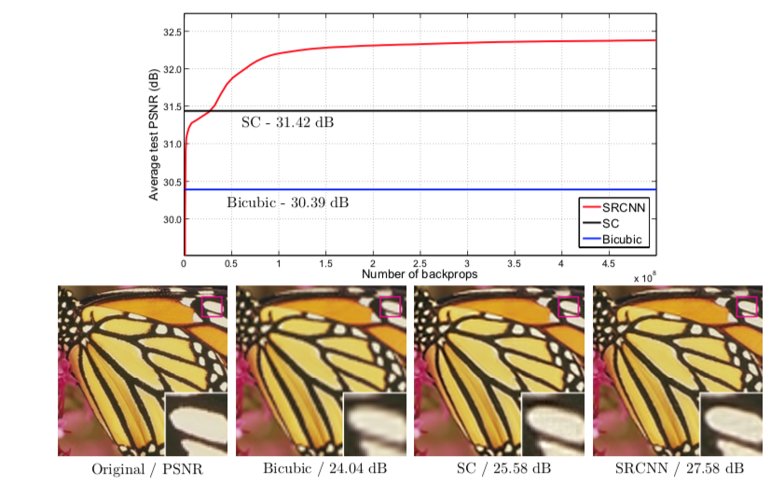
An early CNN paper (2016)
Dong, Chao, et al. "Learning a deep convolutional network for image super-resolution." European conference on computer vision. Springer, Cham, 2014.

Slide 36
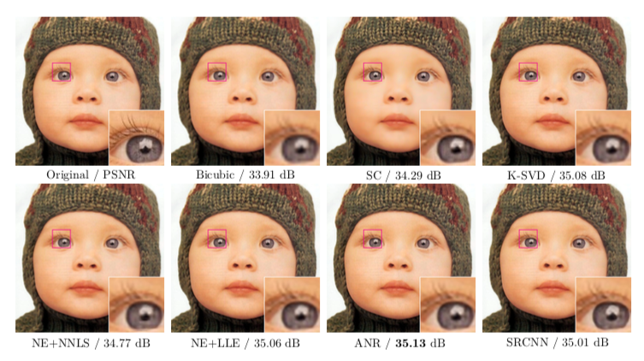
An early CNN paper (2016)
Upscaling factor of 3 !
Dong, Chao, et al. "Learning a deep convolutional network for image super-resolution." European conference on computer vision. Springer, Cham, 2014.

Slide 37
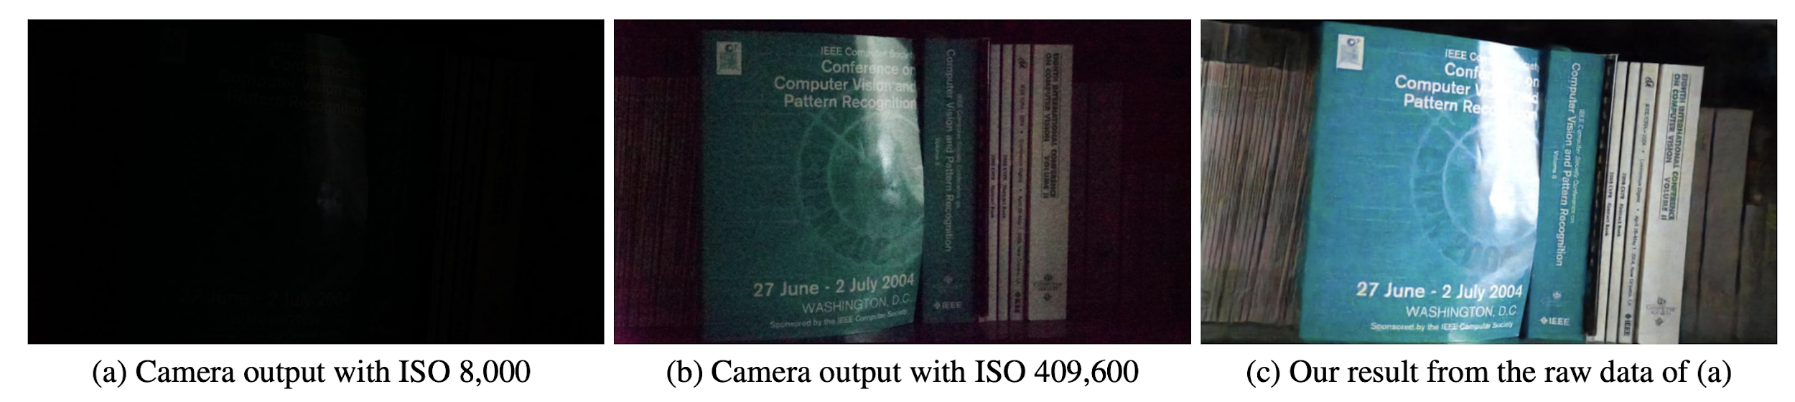
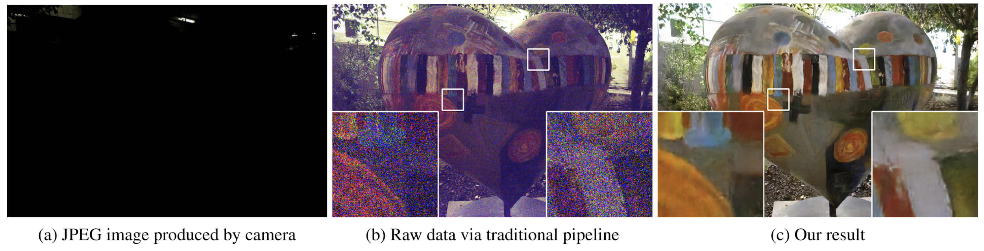
Underexposed Photo Enhancement
Goal: enhance extreme low-light imaging with severely limited illumination (e.g., moonlight) and short exposure (exposure time is set to 1/30 second)
The less light there is, the more ISO you need
High ISO can be used to increase brightness, but amplifies noise
Leads to low signal-to-noise ratio (SNR) due to low photon counts
Learning to See in the Dark. Qifeng Chen, Vladlen Koltun. CVPR 2018.

Slide 38
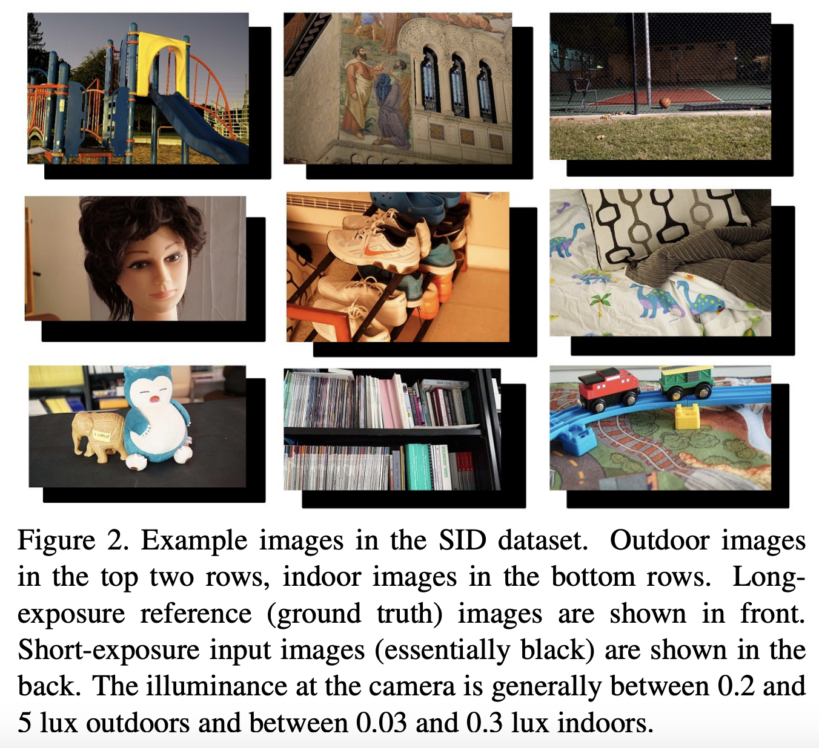
Solution? Collect dataset and train a deep network
See-in-the-Dark (SID) dataset contains 5094 raw short exposure images, each with a corresponding long-exposure reference image
Corresponding reference (ground truth) images captured with 100-300x longer exposure (i.e. 10 to 30 seconds)
Overcome low photon counts!
Train deep neural networks to learn the image processing pipeline w/ L1 loss.
Learning to See in the Dark. Qifeng Chen, Vladlen Koltun. CVPR 2018.

Slide 39
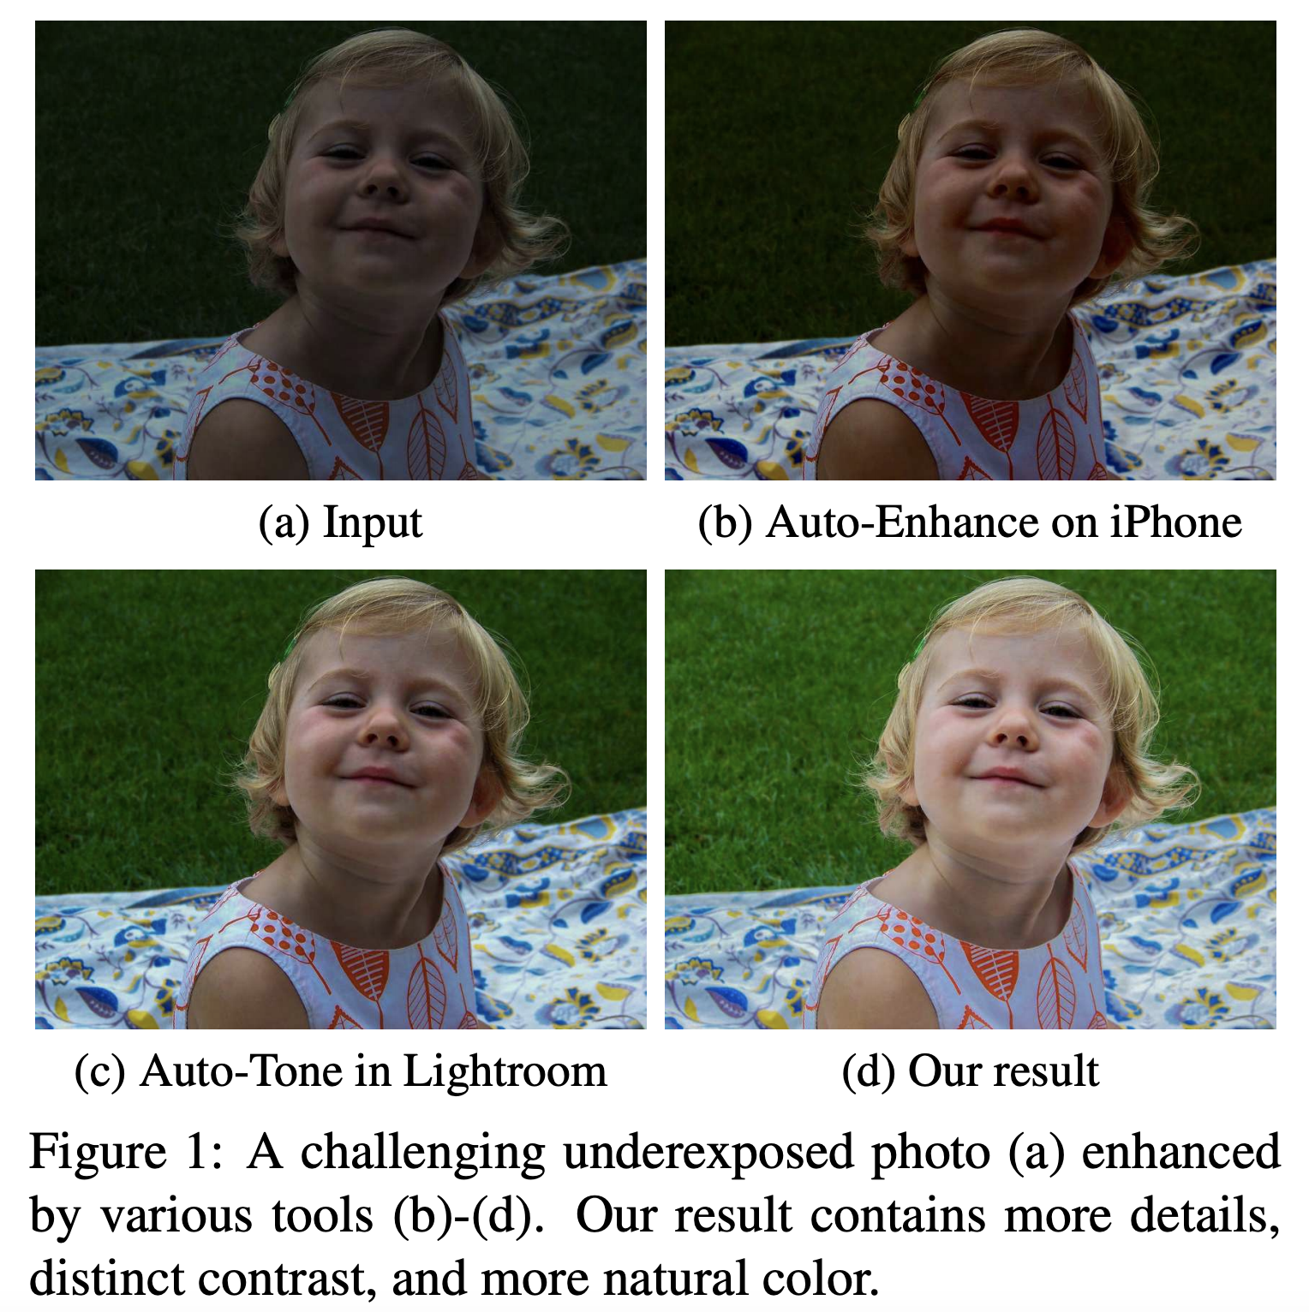
Underexposed Photo Enhancement
Learn image-to-image mapping? Too hard!
Instead estimate an image-to-illumination mapping (model varying-lighting conditions)
Illumination maps for natural images typically have relatively simple forms with known priors
Then take illumination map to light up the underexposed photo.
Minimize (reconstruction loss + smoothness loss + color loss)
Underexposed Photo Enhancement Using Deep Illumination Estimation. Wang et al. CVPR 2019.

Slide 40
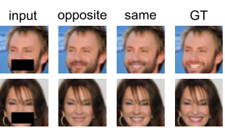
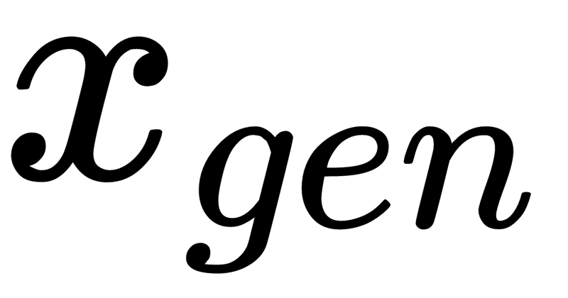
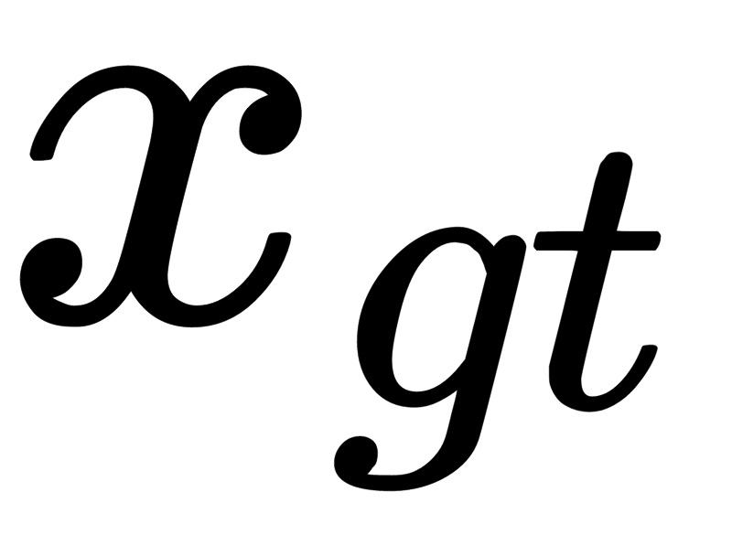

Image Inpainting
Perceptual loss is added to ELBO, the typical objective function used in variational autoencoders, to increase the sharpness and overall quality of inpainted images
Demonstrate results on attribute-guided image completion
input
not smiling
smiling
ground truth
: generated image
: ground truth image
: activation of the l^{th} layer of a pre-trained VGG
Variational Image Inpainting. Cusuh Ham*, Amit Raj*, Vincent Cartillier*, Irfan Essa. NeuRIPS 2018 Workshop.

Slide 41
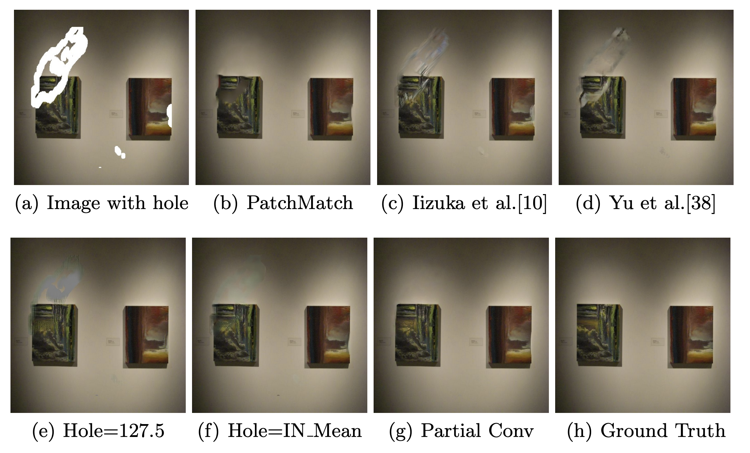
Image Inpainting
Proposes partial convolutions, comprised of a masked & re-normalized convolution operator
Updates mask automatically after partial convolutions, removing any masking where partial convolution was able to operate on unmasked value
Image Inpainting for Irregular Holes Using Partial Convolutions. Liu et al. ECCV 2018.

